Slide 1
Introduction to Time Series
Saarthak Mehra

Slide 2

Agenda
Intro to Time Series
Time-Series Behavior
Forecasting Time-Series

Slide 3

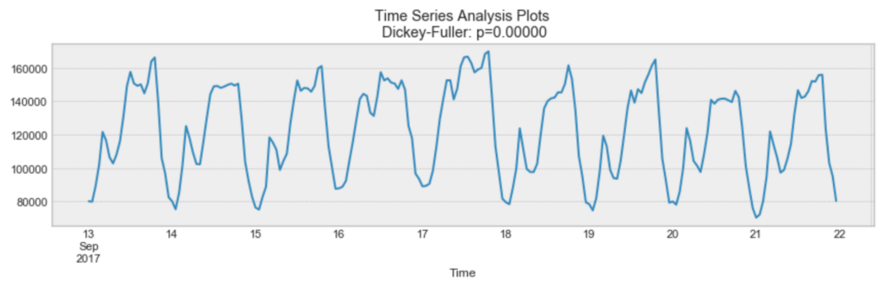
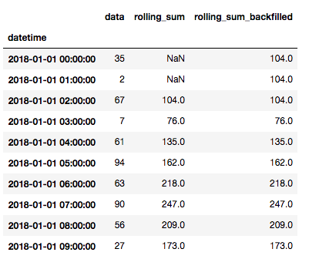
What is time-series?
A sequence of observations taken over equal intervals over time.
What do they look like?
Univariate
Multivariate
A
A
B

Slide 4
Time series can be analyzed in any business that operates an online platform (website, blog, etc.)
Why do we care?
Trivial Time Series Analysis
Around 10 AM, there are 100,000 online users
At 10AM, we need all of our servers on.
Around 8 PM, there are 15,000 online users
At 8PM, we only need some of our servers on.
From the above observations, we are able to save money by turning off an X amount of servers at 8 PM, thereby increasing efficiency.

Slide 5



Statsmodels
Provides tools for statistical modeling
Important libraries for time-series modeling you need to know
Scikit Learn
Anything machine learning (from regression to clustering to parameter tuning)

Slide 6
Types of Time-Series Data
Deterministic vs Non-Deterministic
Additive vs Multiplicative
Stationary vs Non-Stationary

Slide 7
Deterministic vs Non-Deterministic
Deterministic time series can be expressed with a single equation.
More about it:
Harder to predict future values.
Variance changes time
Mean changes time
More about it:
Future values can easily be predicted.
Variance remains constant
Mean changes with time
Non-Deterministic time series can not be expressed with a single equation

Slide 8
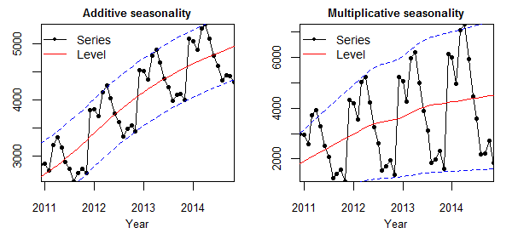
Additive vs Multiplicative
Additive:
sum of the components;
tends to show a linear trend;
data is measured in absolute quantity
Data can be modeled as either additive or multiplicative
Multiplicative:
product of the components;
tends to show an exponential trend;
Data is measured in percent change

Slide 9
Stationary vs Non-Stationary
Stationary
Statistical properties are constant
Mean
Variance
Autocorrelation → correlation of the series with its previous values
Independent of time
Easier to predict future values
No seasonality
Non-Stationary
Trend → A general pattern for a long time period
Example: A general increase in the number of UBER rides called in San Francisco.
Seasonality → Repeating pattern in the data during a fixed time period
Example: An increase in the number of UBER rides on Friday nights in downtown San Francisco.
Irregularity → Non-repeating behavior within a short time period
Example: A sudden decrease in the number of UBER rides due to a sudden snowstorm.
Cyclic → Repeating behavior occurring at irregular time intervals
Usually caused by the business itself or other socioeconomic factors

Slide 10
Time-Series Forecasting
Attempting to make the data stationary
Selecting the appropriate model
Evaluating model accuracy

Slide 11
Time-Series Models: ARIMA
Auto Regression
models the next step in the sequence as a linear function of the observations at prior time steps.
p == order of AR (number of lags to be used as predictors)
Moving Average
models the next step in the sequence as a linear function of the residual errors from a mean process at prior time steps
q == order of MA (number of lags to be used as predictors)
ARIMA
ARIMA → works well with time series with trend but without seasonality
The “I” in ARIMA represents the number of differences (d) made in order to make time-series stationary
Differencing?

Slide 12
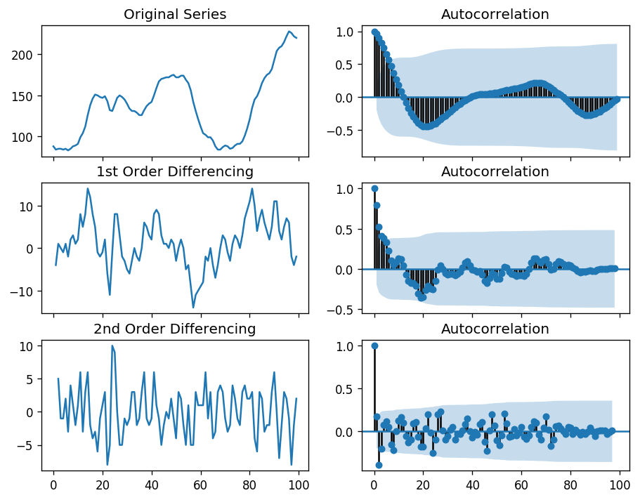
Purpose of differencing?
To minimize autocorrelation while the time-series remains greater than 0
“Weak stationarity”
In the second order of differencing, autocorrelation went negative too quick, which suggests…
← overdifferencing

Slide 13
Time-Series Models: SARIMA
If our data is measured in days, and the data shows a repeating pattern every seven days (weekly seasonality), then m = 7. So at every future time step…
Auto Regressive
Integrated
Moving Average
Seasonality
AR(p), I(d), and AM(q) will be dependent on every time step in the past
AR(P), I(D), and AM(Q) will be dependent on past time steps from every 7 days (week)
SARIMA(p, d, q)(P, D, Q)m
p, d, q → remember from ARIMA
m → number of time steps in each season
P, D, Q → same as (p, d, q), but only active based on m

Slide 14
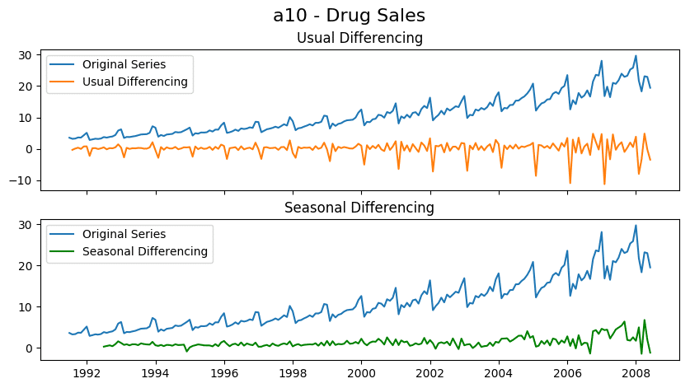
ARIMA based differencing
With seasonality represented as a parameter, you can repeat the ability to perform:
i) autoregression
ii) differencing
iii) moving average
modeling like ARIMA did at the seasonal level.
SARIMA based differencing

Slide 15
More Time-Series Models
SARIMAX: Seasonal Autoregressive Integrated Moving-Average with Exogenous Regressors
VAR: Vector Autoregression
VARMA: Vector Autoregression Moving-Average
VARMAX: Vector Autoregression Moving-Average with Exogenous Regressors
SES: Simple Exponential Smoothing
HWES: Holt Winter’s Exponential Smoothing
FbProhet: Open source model made by Facebook; takes holidays into account
LSTM: Long Short Term Memories
NNETAR: Neural Network Autoregression

Slide 16
Evaluating Model Accuracy
Accuracy Metrics
MAPE → Mean Absolute Percentage Error
ME → Mean Error
MAE → Mean Absolute Error
MPE → Mean Percentage Error
RMSE → Root Mean Squared Error
ACF1 → Lag 1 Autocorrelation of Error
corr → Correlation between the Actual and the Forecast
Minmax → Min-Max Error

Slide 17
Interesting/Useful Information

Slide 18
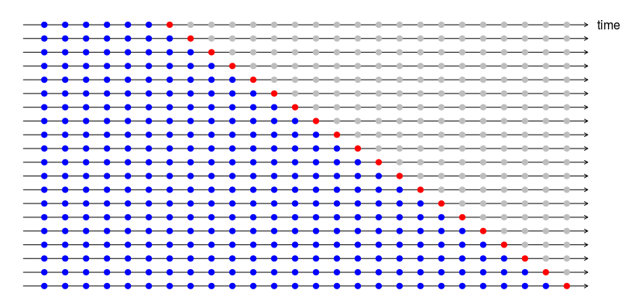
Cross-Validation technique used to validify model before testing it on the entire training set
Blue → training set
Red → validation set

Slide 19
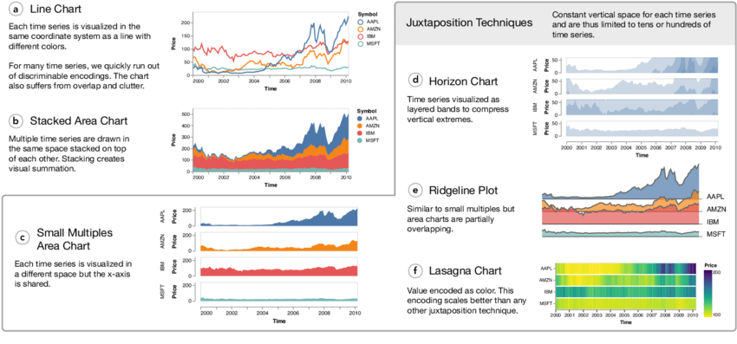
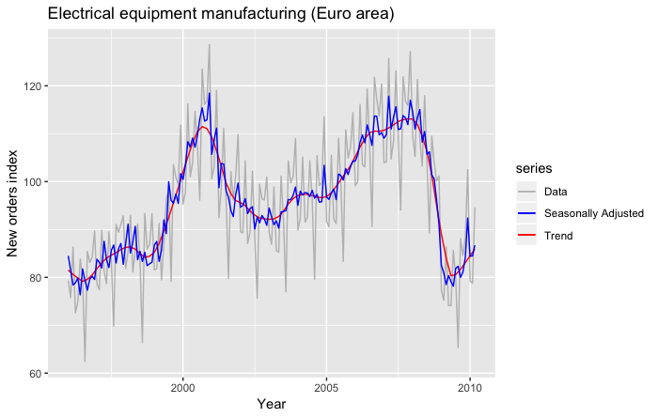
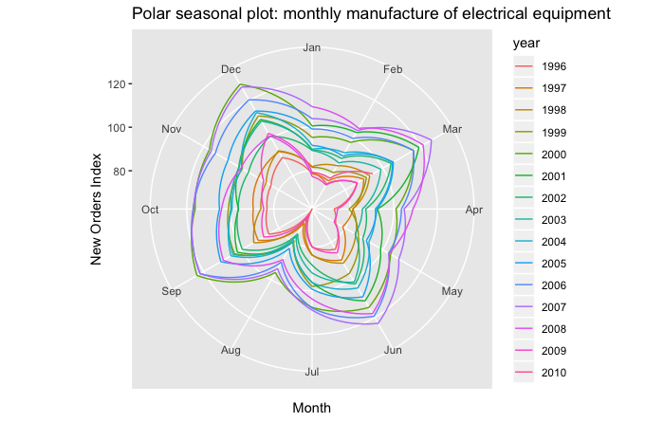
Visualizations
Avoid sticking to stock visualizations from matplotlib
Ensure that every visualization is practical, innovative, and creative

Slide 20
Thank you for attending!

